Slide 1
Chapter 2
Analyzing the Business Case

Slide 2
Learning Objectives (1 of 2)
After this chapter, you will be able to:
Describe the strategic planning process
Conduct a SWOT analysis
Explain how tools can support strategic planning
Explain the concept of a business case
Summarize the six main reasons for systems requests
Describe the two factors affecting systems projects

Slide 3
Learning Objectives (2 of 2)
Explain how systems requests are processed
Explain how systems request feasibility is assessed
Explain how systems requests are prioritized
Conduct a preliminary investigation

Slide 4
Strategic Planning (1 of 4)
Process of identifying long-term organizational goals, strategies, and resources
Starts with a mission statement
Reflects the vision, purpose, and values
Critical success factor: high-priority objective
SWOT analysis
Strengths, weaknesses, opportunities, and threats
Examines technical, human, and financial resources

Slide 5
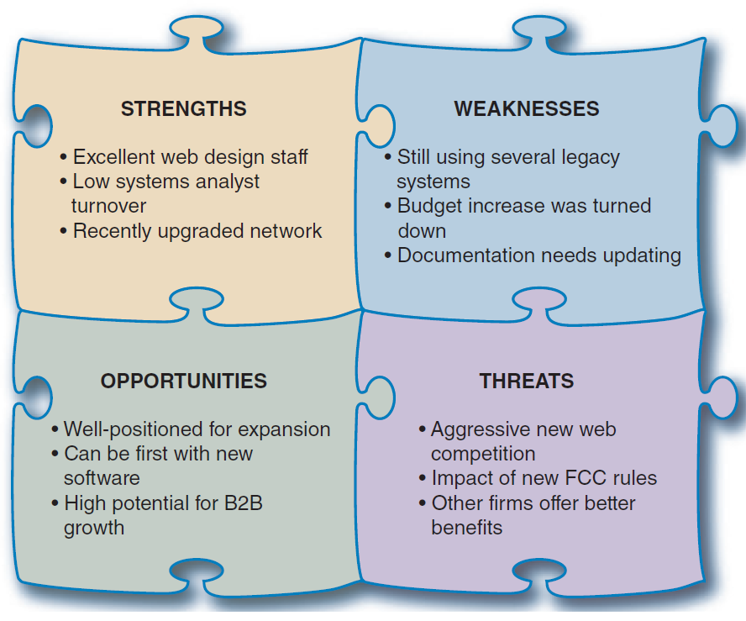
Strategic Planning (2 of 4)
FIGURE 2-1 A SWOT analysis might produce results similar to those shown here.

Slide 6
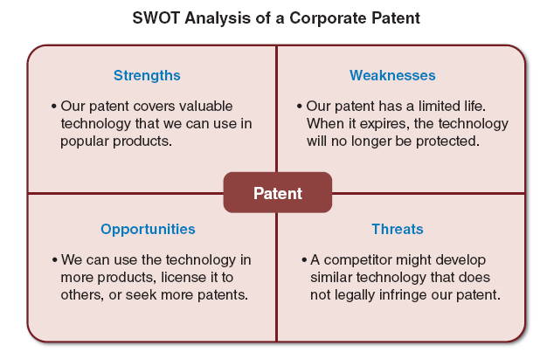
Strategic Planning (3 of 4)
FIGURE 2-2 This SWOT analysis example focuses on a specific asset, such as a company patent.

Slide 7
Strategic Planning (4 of 4)
The role of the IT department
Careful project planning
Supports overall business strategy and operational needs
Scope is well-defined and clearly stated
Goals are realistic, and tied to specific statements, assumptions, constraints, factors, and other inputs

Slide 8
Strategic Planning Tools
Approaches vary
Microsoft Word and Excel
CASE tools
Mind maps
Balanced scorecards
Gap analysis

Slide 9
The Business Case
Justification for a proposal
Comprehensive and easy to understand
Describe the project clearly, provide justification to proceed, and estimate financial impact
Many questions answered
Why are we doing this project?
How much will it cost and how long will it take?
Are there any risks involved?
How will we measure success?
What alternatives exist?

Slide 10
Systems Requests (1 of 2)
Starting point for most information systems projects
Formal way of asking for IT support
Stronger controls
More information
Better performance
Improved service
More support for new products and services

Slide 11
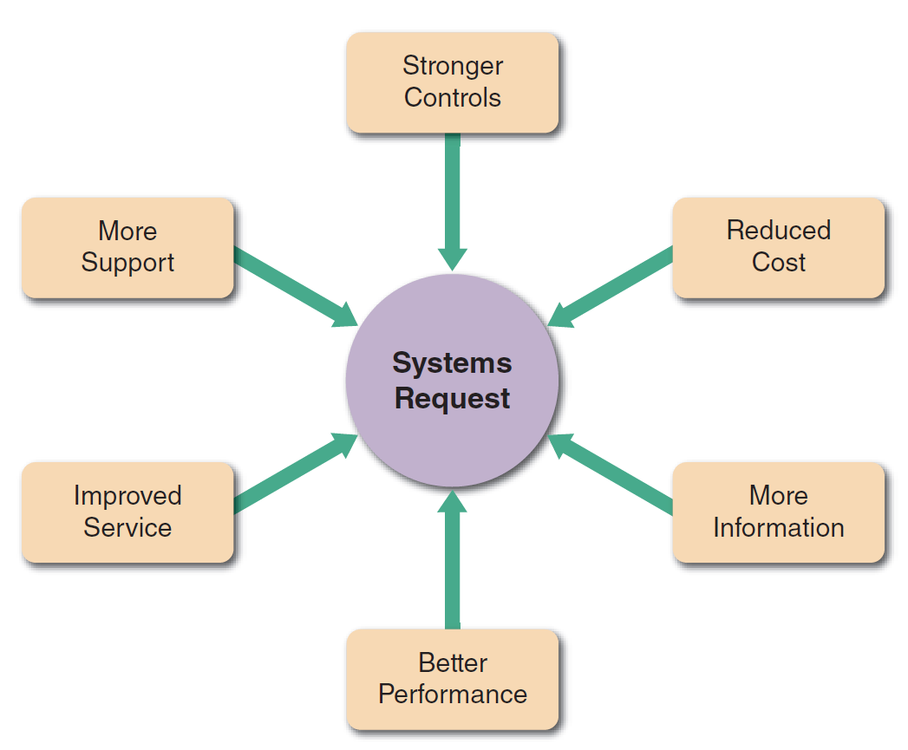
Systems Requests (2 of 2)
FIGURE 2-4 Six main reasons for systems requests.

Slide 12
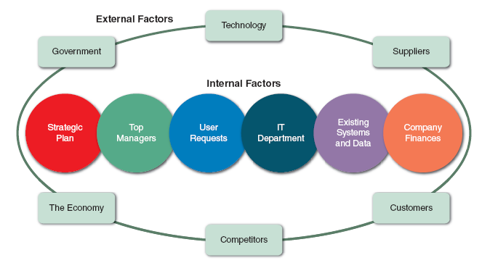
Factors Affecting Systems Projects
FIGURE 2-6 Internal and external factors that affect IT projects.

Slide 13
Processing Systems Request (1 of 3)
Systems review committee or a computer resources committee
Evaluated systems requests
Systems request forms
Streamline the request process
Ensure consistency
Easy to understand
Include clear instructions
Indicate required supporting documents
Submitted electronically

Slide 14
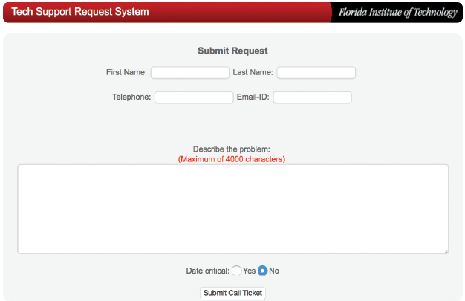
Processing Systems Request (2 of 3)
FIGURE 2-10 Example of an online systems request form.
Source: Florida Institute of Technology

Slide 15
Processing Systems Request (3 of 3)
Systems request tools
Used to help manage workflow
Systems review committee
Broader viewpoint enables a committee to establish priorities more effectively
One person’s bias is less likely to affect decisions
Disadvantages
Action on requests must wait until committee meets
Members might favor projects requested by their own departments

Slide 16
Assessing Request Feasibility (1 of 7)
Feasibility studies can be simple or exhaustive
Effort required depends on nature of request
Initial fact-finding
Studying organizational charts
Performing interviews
Reviewing current documentation
Observing operations
Surveying users

Slide 17
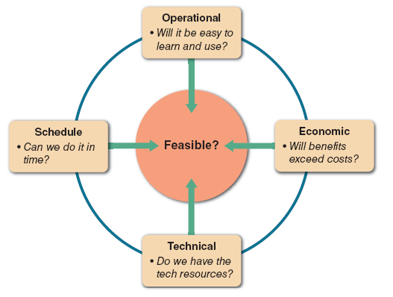
Assessing Request Feasibility (2 of 7)
FIGURE 2-11 A feasibility study examines operational, technical, economic, and schedule factors.

Slide 18
Assessing Request Feasibility (3 of 7)
Operational feasibility
Proposed system will be used effectively after it has been developed
Can be affected by organizational culture
Cannot be accurately measured but requires careful study
Questions that can help predict feasibility
Is the project supported by management and users?
Will the new system result in a workforce reduction?
Do legal or ethical issues need to be considered?

Slide 19
Assessing Request Feasibility (4 of 7)
Economic feasibility
Projected benefits of a proposed system out-weigh total cost of ownership (TCO)
Determination of TCO requires cost analysis
People, including IT staff and users
Hardware and equipment
Software
Formal and informal training
Licenses and fees
Consulting expenses and facility costs
Estimated cost of not developing or postponing

Slide 20
Assessing Request Feasibility (5 of 7)
Costs and benefits
Tangible costs are measured in dollars
Intangible costs can significantly affect organizational performance
Tangible benefits can result from a decrease in expenses or an increase in revenues
Intangible benefits are important to the company despite the inability to measure them in dollars

Slide 21
Assessing Request Feasibility (6 of 7)
Technical feasibility
Technical resources required to develop and operate the system
Questions analysts should ask
Does the company have the necessary hardware, software, and network resources?
Does the company have the required technical expertise?
Does the proposed platform have sufficient capacity for future needs?
Will a prototype be required?

Slide 22
Assessing Request Feasibility (7 of 7)
Schedule feasibility
Project implemented in an acceptable time frame
Issue: interaction between time and costs
Additional schedule feasibility issues
Can the company or the IT team control the factors that affect schedule feasibility?
Has management established a firm timetable?
What conditions must be satisfied?
Will an accelerated schedule pose any risks?
Will project management techniques be available?

Slide 23
Setting Priorities (1 of 3)
Dynamic priorities
Changes can cause request priorities to change
Factors that affect priority
Will the proposed system reduce costs?
Will the system increase revenue?
Will the systems project result in more information or produce better results?
Will the system serve customers better?
Will the system serve the organization better?

Slide 24
Setting Priorities (2 of 3)
Can the project be implemented in a reasonable time period?
Are the necessary financial, human, and technical resources available?

Slide 25
Setting Priorities (3 of 3)
Discretionary projects
Projects where management has a choice in implementing them
Nondiscretionary projects
No choice
Many are predictable
Annual updates to payroll
Tax percentages
Quarterly changes

Slide 26
The Preliminary Investigation (1 of 9)
Planning the preliminary investigation
Meet with key managers, users, and IT staff to describe the project, explain responsibilities, answer questions, and invite comments
Focus on improvements and enhancements, not problems

Slide 27
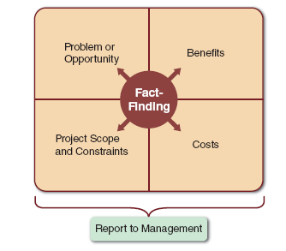
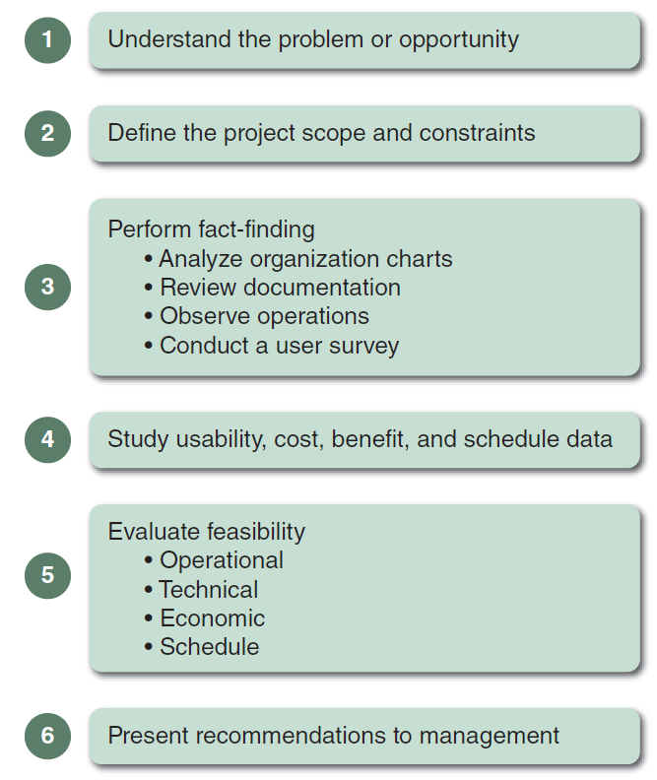
The Preliminary Investigation (2 of 9)
FIGURE 2-13 Model of a preliminary investigation. Notice the importance of fact-finding in each of the four areas.
FIGURE 2-14 Six main steps in a typical preliminary investigation.

Slide 28
The Preliminary Investigation (3 of 9)
Planning the preliminary investigation
Step 1: understand the problem or opportunity
Develop a business profile that describes current business processes and functions
Understand how modifications will affect business operations and other information systems
Identify the departments, users, and business processes involved
Consider using a fishbone diagram

Slide 29
The Preliminary Investigation (4 of 9)
Step 2: define the project scope and constraints
Define specific boundaries, or extent, of the project
Create a list with must do, should do, could do, and won’t do sections
Avoid project creep
Identify constraints

Slide 30
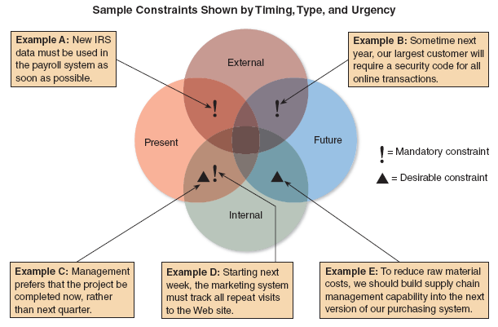
The Preliminary Investigation (5 of 9)
FIGURE 2-16 Examples of various types of constraints.

Slide 31
The Preliminary Investigation (6 of 9)
Step 3: perform fact-finding
Gather data about project usability, costs, benefits, and schedules
Analyze organization charts
Conduct interviews
Review documentation
Observe operations
Conduct a user survey
Analyze the data

Slide 32
The Preliminary Investigation (7 of 9)
Step 4: analyze project usability, cost, benefit, and schedule data
What information must be obtained, and how will it be gathered and analyzed?
Who will conduct the interviews? How many people will be interviewed?
Will a survey be conducted? Who will be involved? How much time will it take to tabulate the results?
How much will it cost to analyze the information and prepare a report with findings and recommendations?

Slide 33
The Preliminary Investigation (8 of 9)
Step 5: evaluate feasibility
Operational feasibility
Technical feasibility
Economic feasibility
Schedule feasibility

Slide 34
The Preliminary Investigation (9 of 9)
Summarizing the preliminary investigation
Format of a report
Introduction
Systems request summary
Findings
Recommendations
Project roles
Time and costs estimates
Expected benefits
Appendix

Slide 35
Summary (1 of 3)
Systems planning
First phase of systems development life cycle
A business case is the reason for a proposed system
Describes the project clearly
Provides justification to proceed
Estimates project’s financial impact

Slide 36
Summary (2 of 3)
Systems projects
Initiated to improve performance, provide more information, reduce costs, strengthen controls, or provide better service
Affected by various internal and external factors

Slide 37
Summary (3 of 3)
Analysts evaluate the systems request
Determine whether the project is feasible
Steps in the preliminary investigation
Understand the problem or opportunity
Define the project scope and constraints
Perform fact-finding and analyze project usability, cost, benefit, and schedule data
Evaluate feasibility
Prepare a report to management

